Slide 1
Turing Machines (TMs)
Turing machine is a model that equal to real computers.
Turing machine was invented by Alan Turing in 1936.
Chomsky Hierarchy:
Unrestricted Grammars
Recognized by
TM
CFLs
PDA
regular
FA

Slide 2
Turing Machines (TMs)
head
a
b
a
b
b
˽
˽
. . .
Finite control
read/write input tape
Head can read and write
Head is two way (can move left or right)
Tape is infinite (to the right)
Infinitely many blanks “˽“ follow input
Can accept or reject any time (not only at end of input)

Slide 3

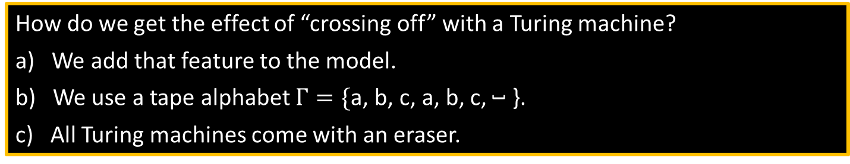
TM – example
TM recognizing $B=\left\{{\text{a}}^{k}{\text{b}}^{k}{\text{c}}^{k} | k≥0\right\}$
Scan right until ˽ while checking if input is in ${\text{a}}^{∗}{\text{b}}^{∗}{\text{c}}^{∗}$, reject if not.
Return head to left end.
Scan right, crossing off single a, b, and c.
If the last one of each symbol crossed, accept.
If the last one of some symbol crossed but not others, reject.
If all symbols remain, return to left end and repeat from (3).
head
input tape
Finite control
a
a
a
b
b
b
c
c
c
˽
˽
accept
How do we get the effect of “crossing off” with a Turing machine?
a) We add that feature to the model.
b) We use a tape alphabet $Γ=\{\text{a}$, $\text{b}$, $\text{c}$, $\text{a}$, $\text{b}$, $\text{c}$, ˽ }.
c) All Turing machines come with an eraser.
Notes:
Ans: b

Slide 4

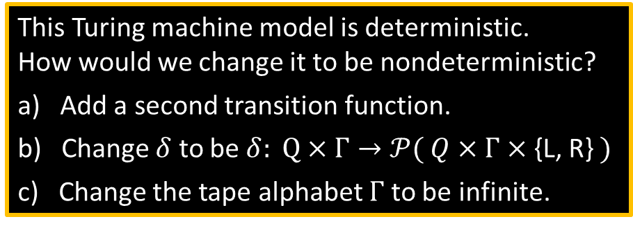

TM – Formal Definition
Defn: A Turing Machine (TM) is a 7-tuple $(Q, Σ, Γ, δ,q_{0}, q\text{acc} , q\text{rej})$
$Σ$ input alphabet
$Γ$ tape alphabet ($Σ⊆Γ$)
$δ: Q×Γ→Q×Γ×$ {L, R} (L = Left, R = Right)
$δ\left(q,\text{a}\right)=(r,\text{b},$ R$)$
On input $w$ a TM $M$ may halt (enter $q\text{acc}$ or $q\text{rej}$) or $M$ may run forever (“loop”).
So $M$ has 3 possible outcomes for each input $w$:
Accept $w$ (enter $q\text{acc}$)
Reject $w$by halting (enter $q\text{rej}$ )
Reject $w$by looping (running forever)
This Turing machine model is deterministic. How would we change it to be nondeterministic?
a) Add a second transition function.
b) Change $δ$ to be $δ: Q×Γ→𝒫( Q×Γ×$ {L, R} $)$
c) Change the tape alphabet $Γ$ to be infinite.
Notes:
Ans: b

Slide 5
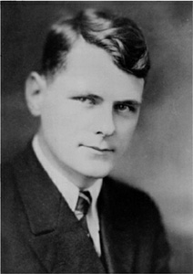
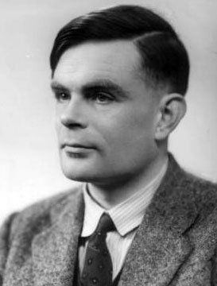
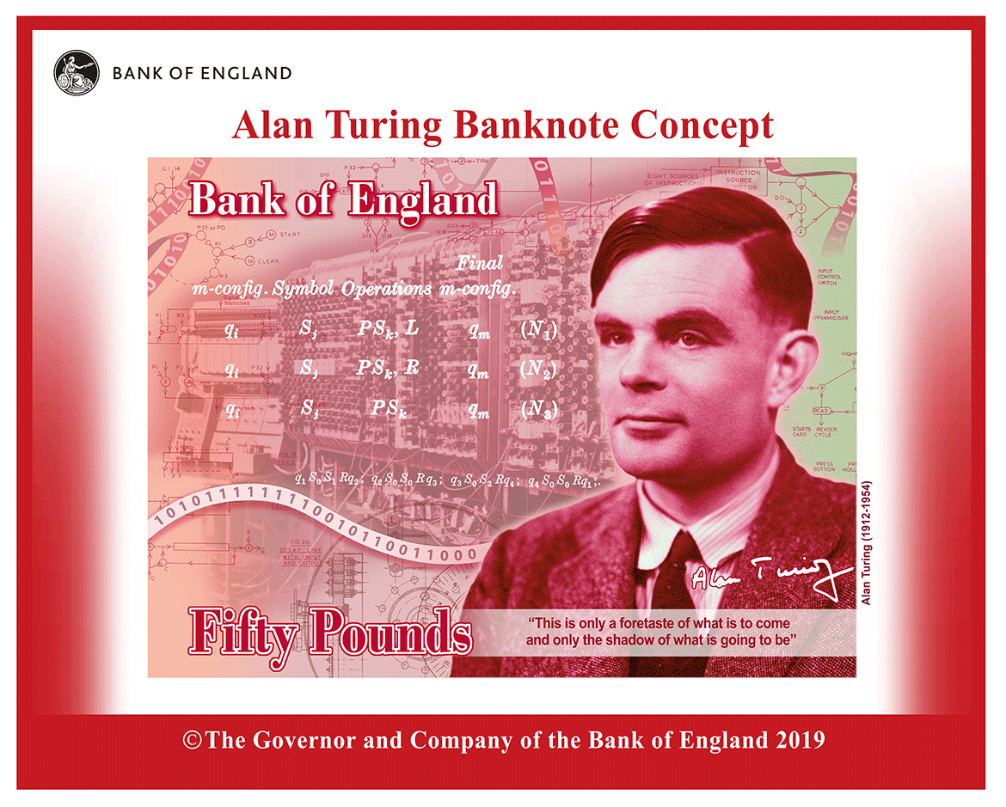
Church-Turing Thesis ~1936
=
Turing
machine
Algorithm
Intuitive
Formal
Alonzo Church
1903–1995
Alan Turing
1912–1954
Which of the following is true about Alan Turing? Check all that apply.
Broke codes for England during WW2.
Worked in AI.
Worked in Biology.
Was imprisoned for being gay.
Appears on a British banknote.
Notes:
Ans: a, b, c, e

